Slide 1


ECEN 404 Final Presentation Team 15: Rogue Chess App Jose Herrera, Travis Head Sponsor: Pranav Dhulipala TA: Eric Robles
About 30 seconds

Slide 2
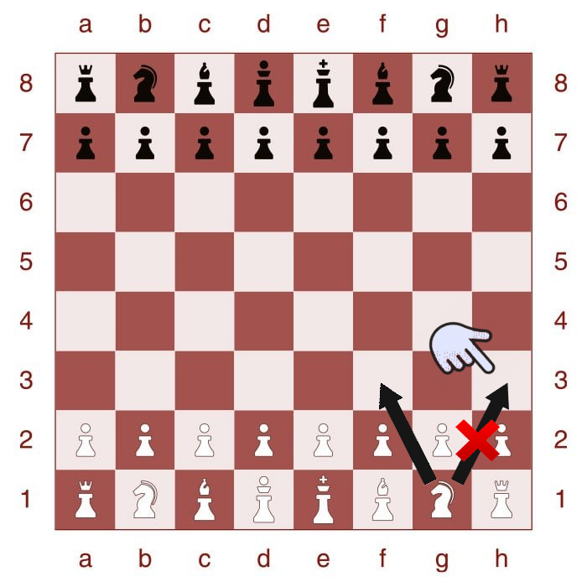
Problem Overview
Problem: There are many variations of the game of chess; however, after a while it can be predictable or lack of excitement.
Proposed Solution: Develop an app of a new chess variation with a randomization factor for Android products.
Develop an AI for Single Player Mode
Create a randomization factor
Create a User Interface for the players interaction
Highlighted boxes to assist the player in making the next move legally
Create different difficulty levels

Slide 3
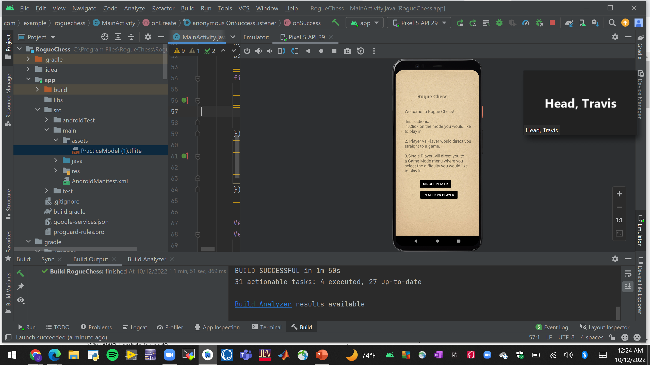
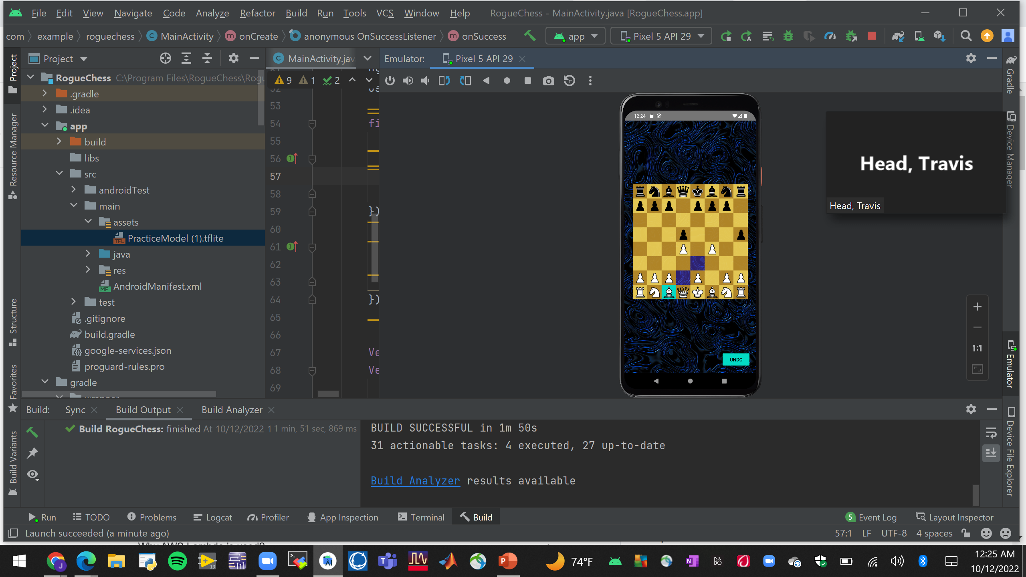
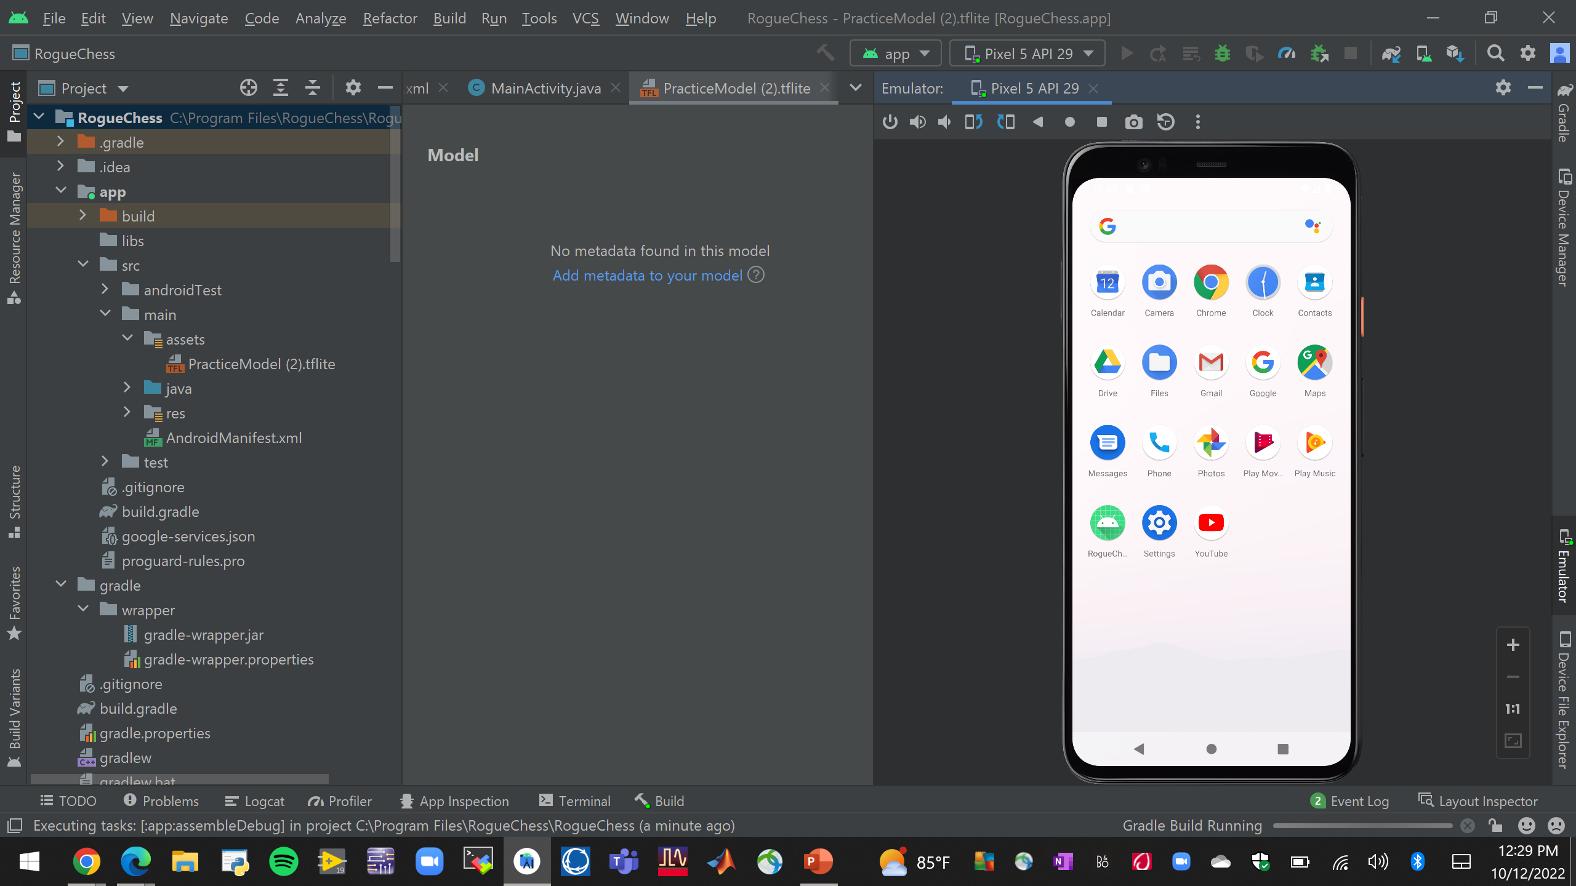
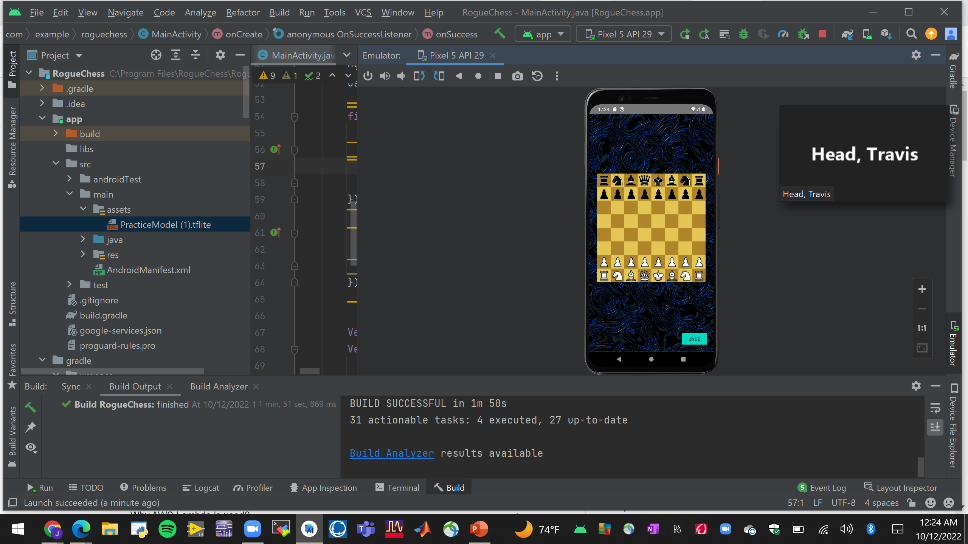
Integrated System Diagram
Select Game Mode
AI or second player move
App is installed
Open App
Player Makes move
When Game Over
Notes:
Eric

Slide 4
App & Game Functionality Jose Herrera
Android Studios Application
App Functions Properly
Does not crash when clicked
Make sure all the function work
Have the app be under 20Mb
User Interface
Graphics look readable
Instructional pages appear
Buttons function properly
App looks appealing to the user
Validations
People reviewed the app
App is playable
Checked phone's storage space and is under 20Mb
Game Functionality
Chess pieces move
Pieces move in a legal way
Pieces move where clicked
Chess Rules are correct
User Interface
Pieces and Board are visible
Highlighted boxes appear to guide the user
Pawn promotion appears when needed
Game over appear when there is a winner

Slide 5
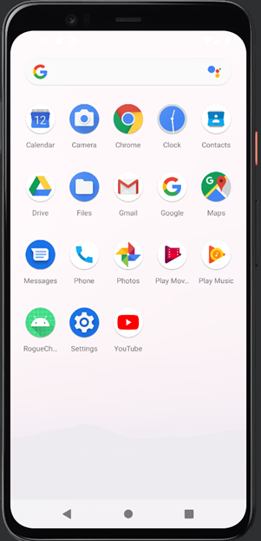
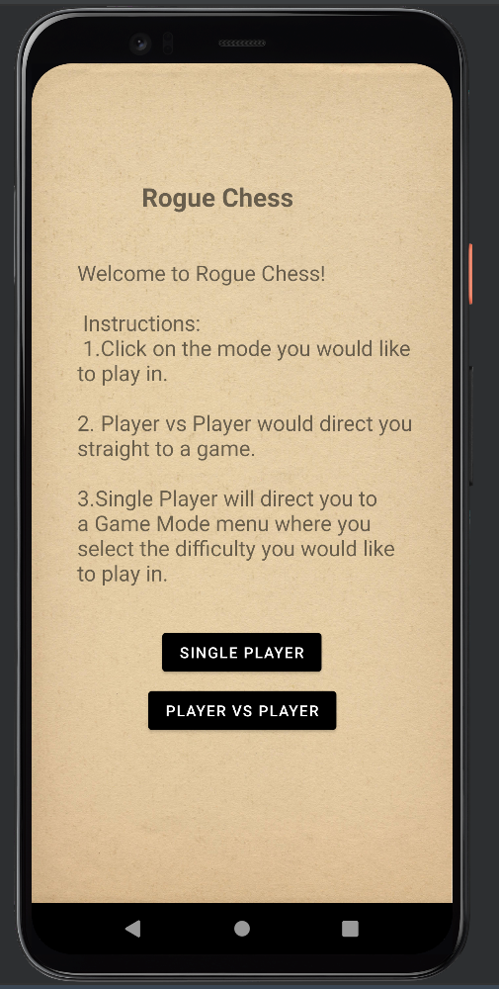
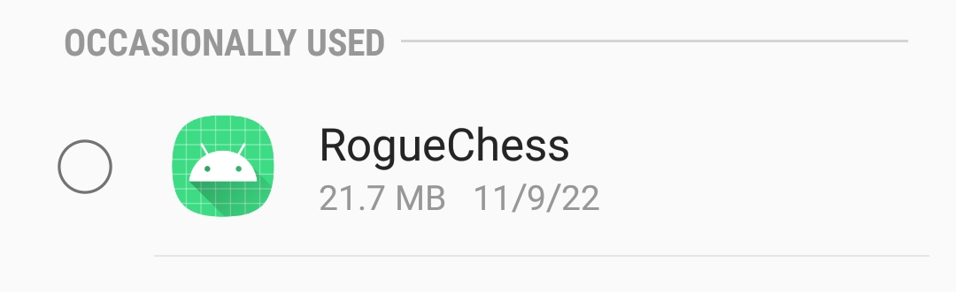
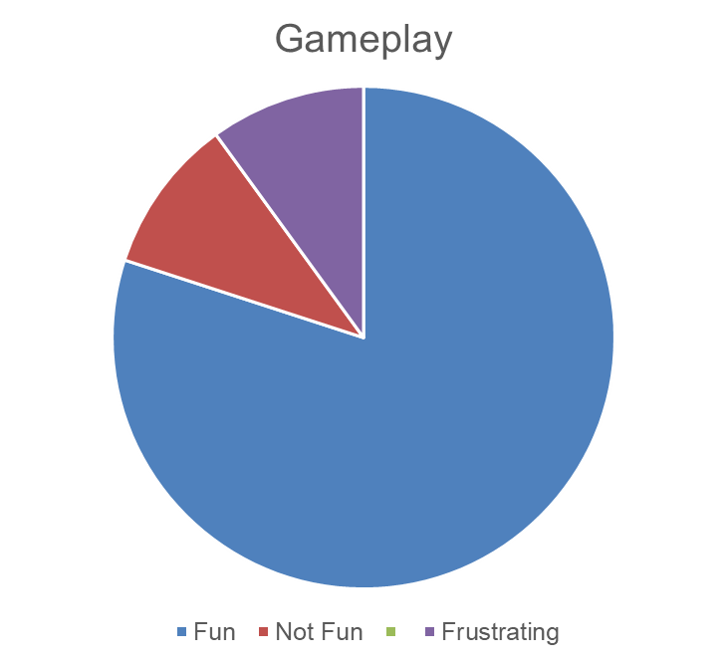
App Functionality Jose Herrera

Slide 6
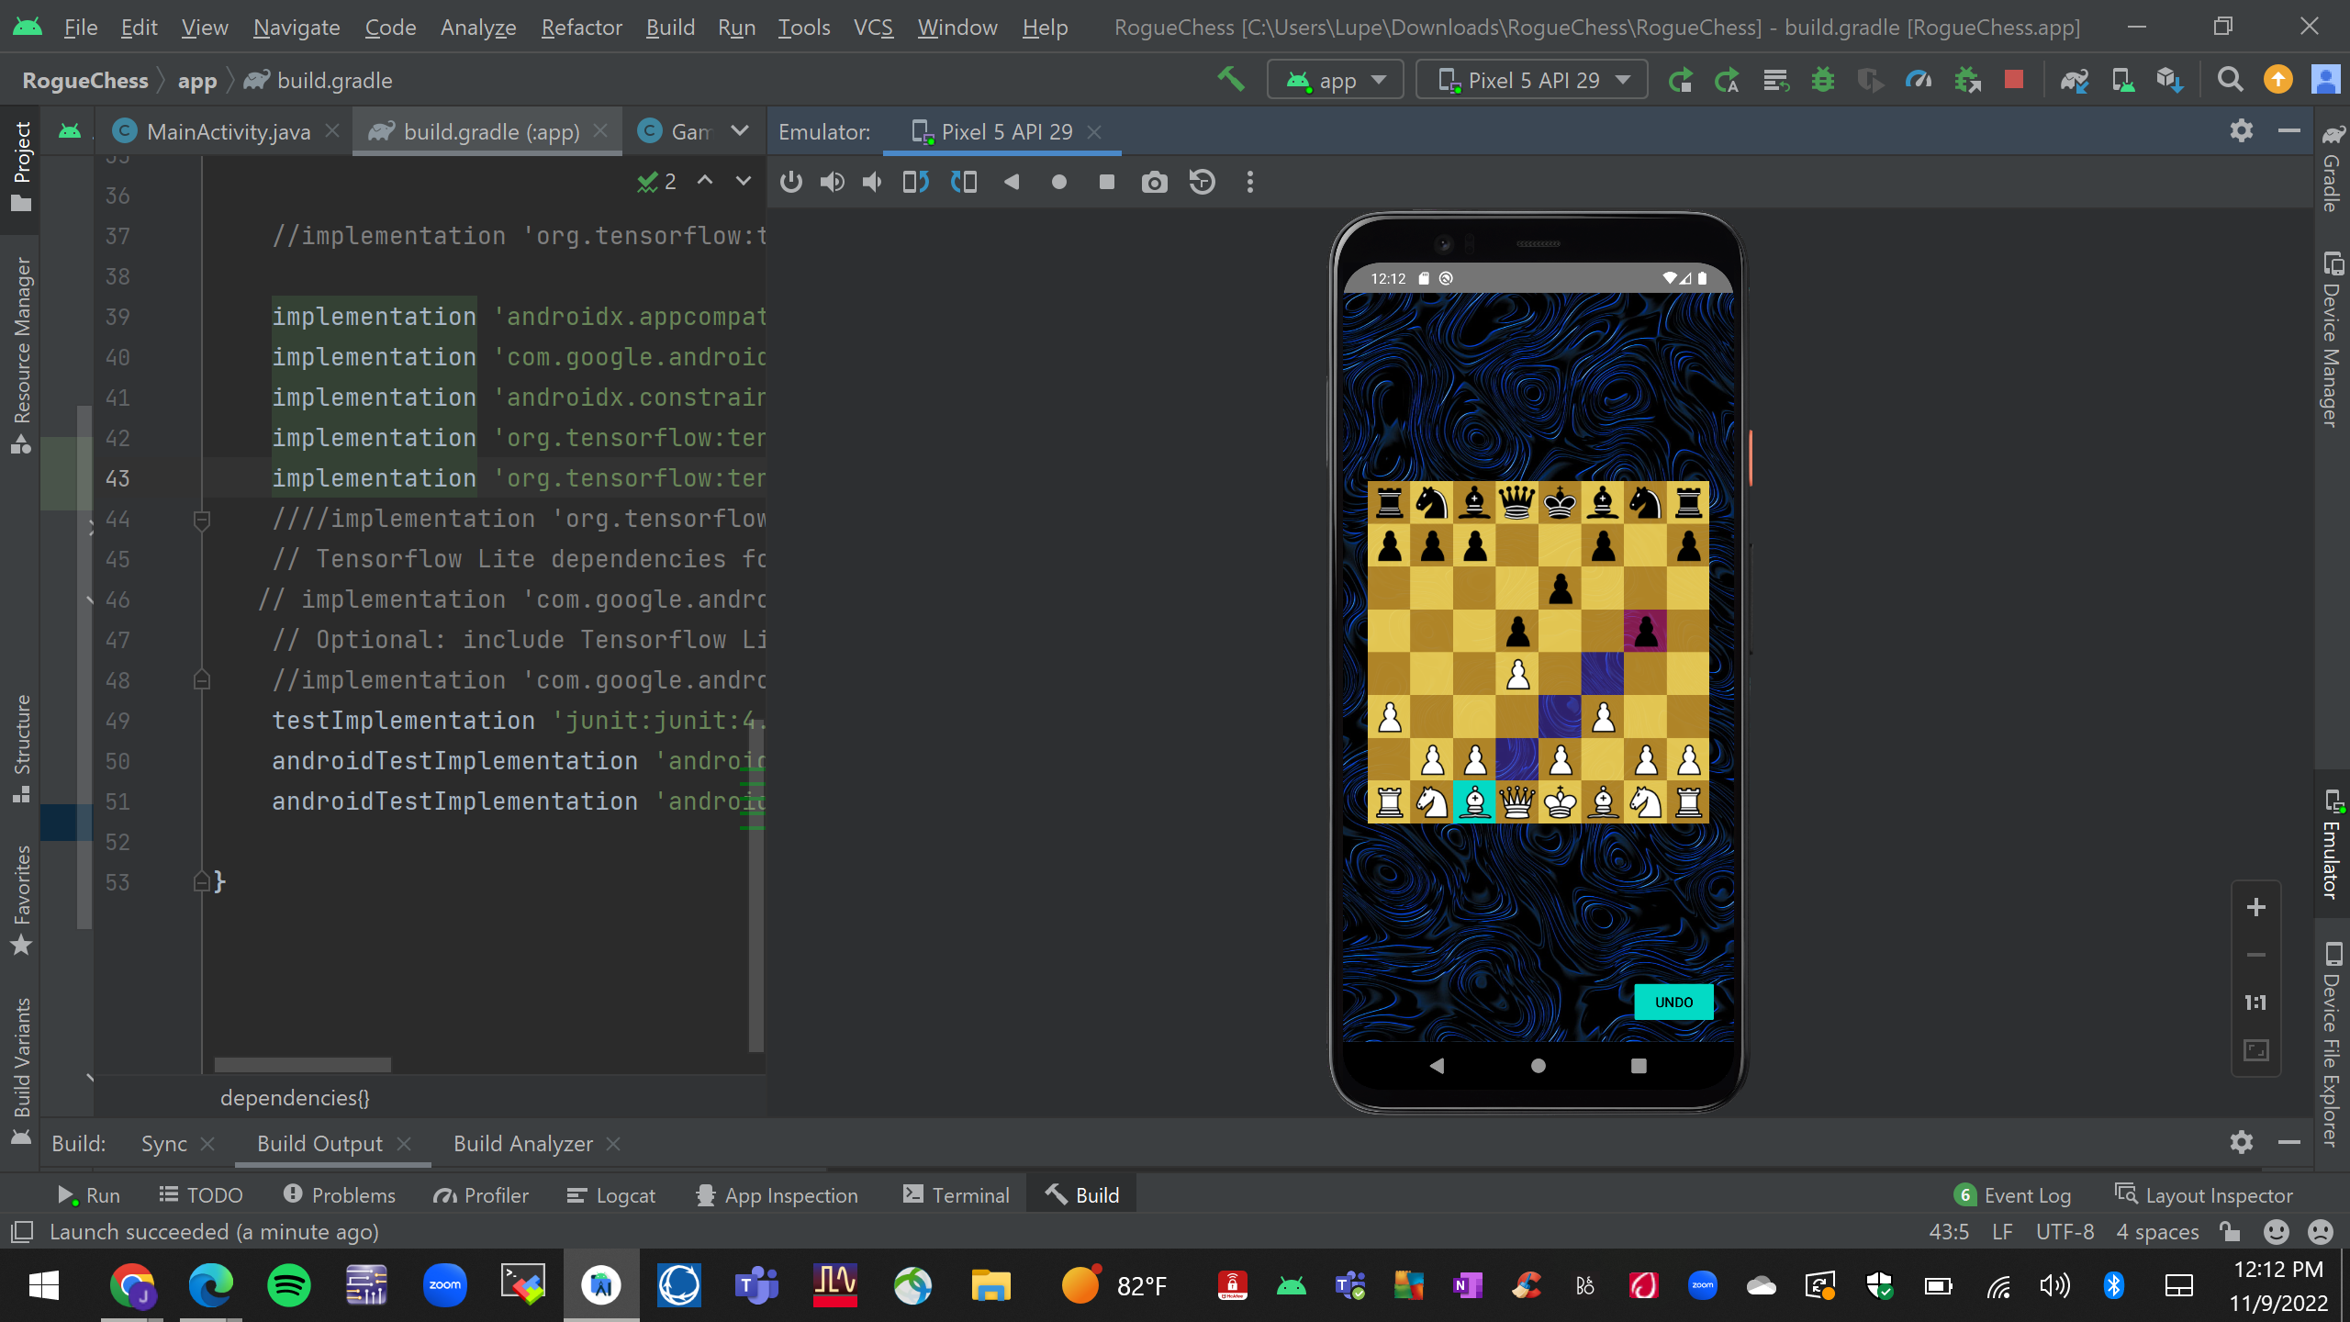
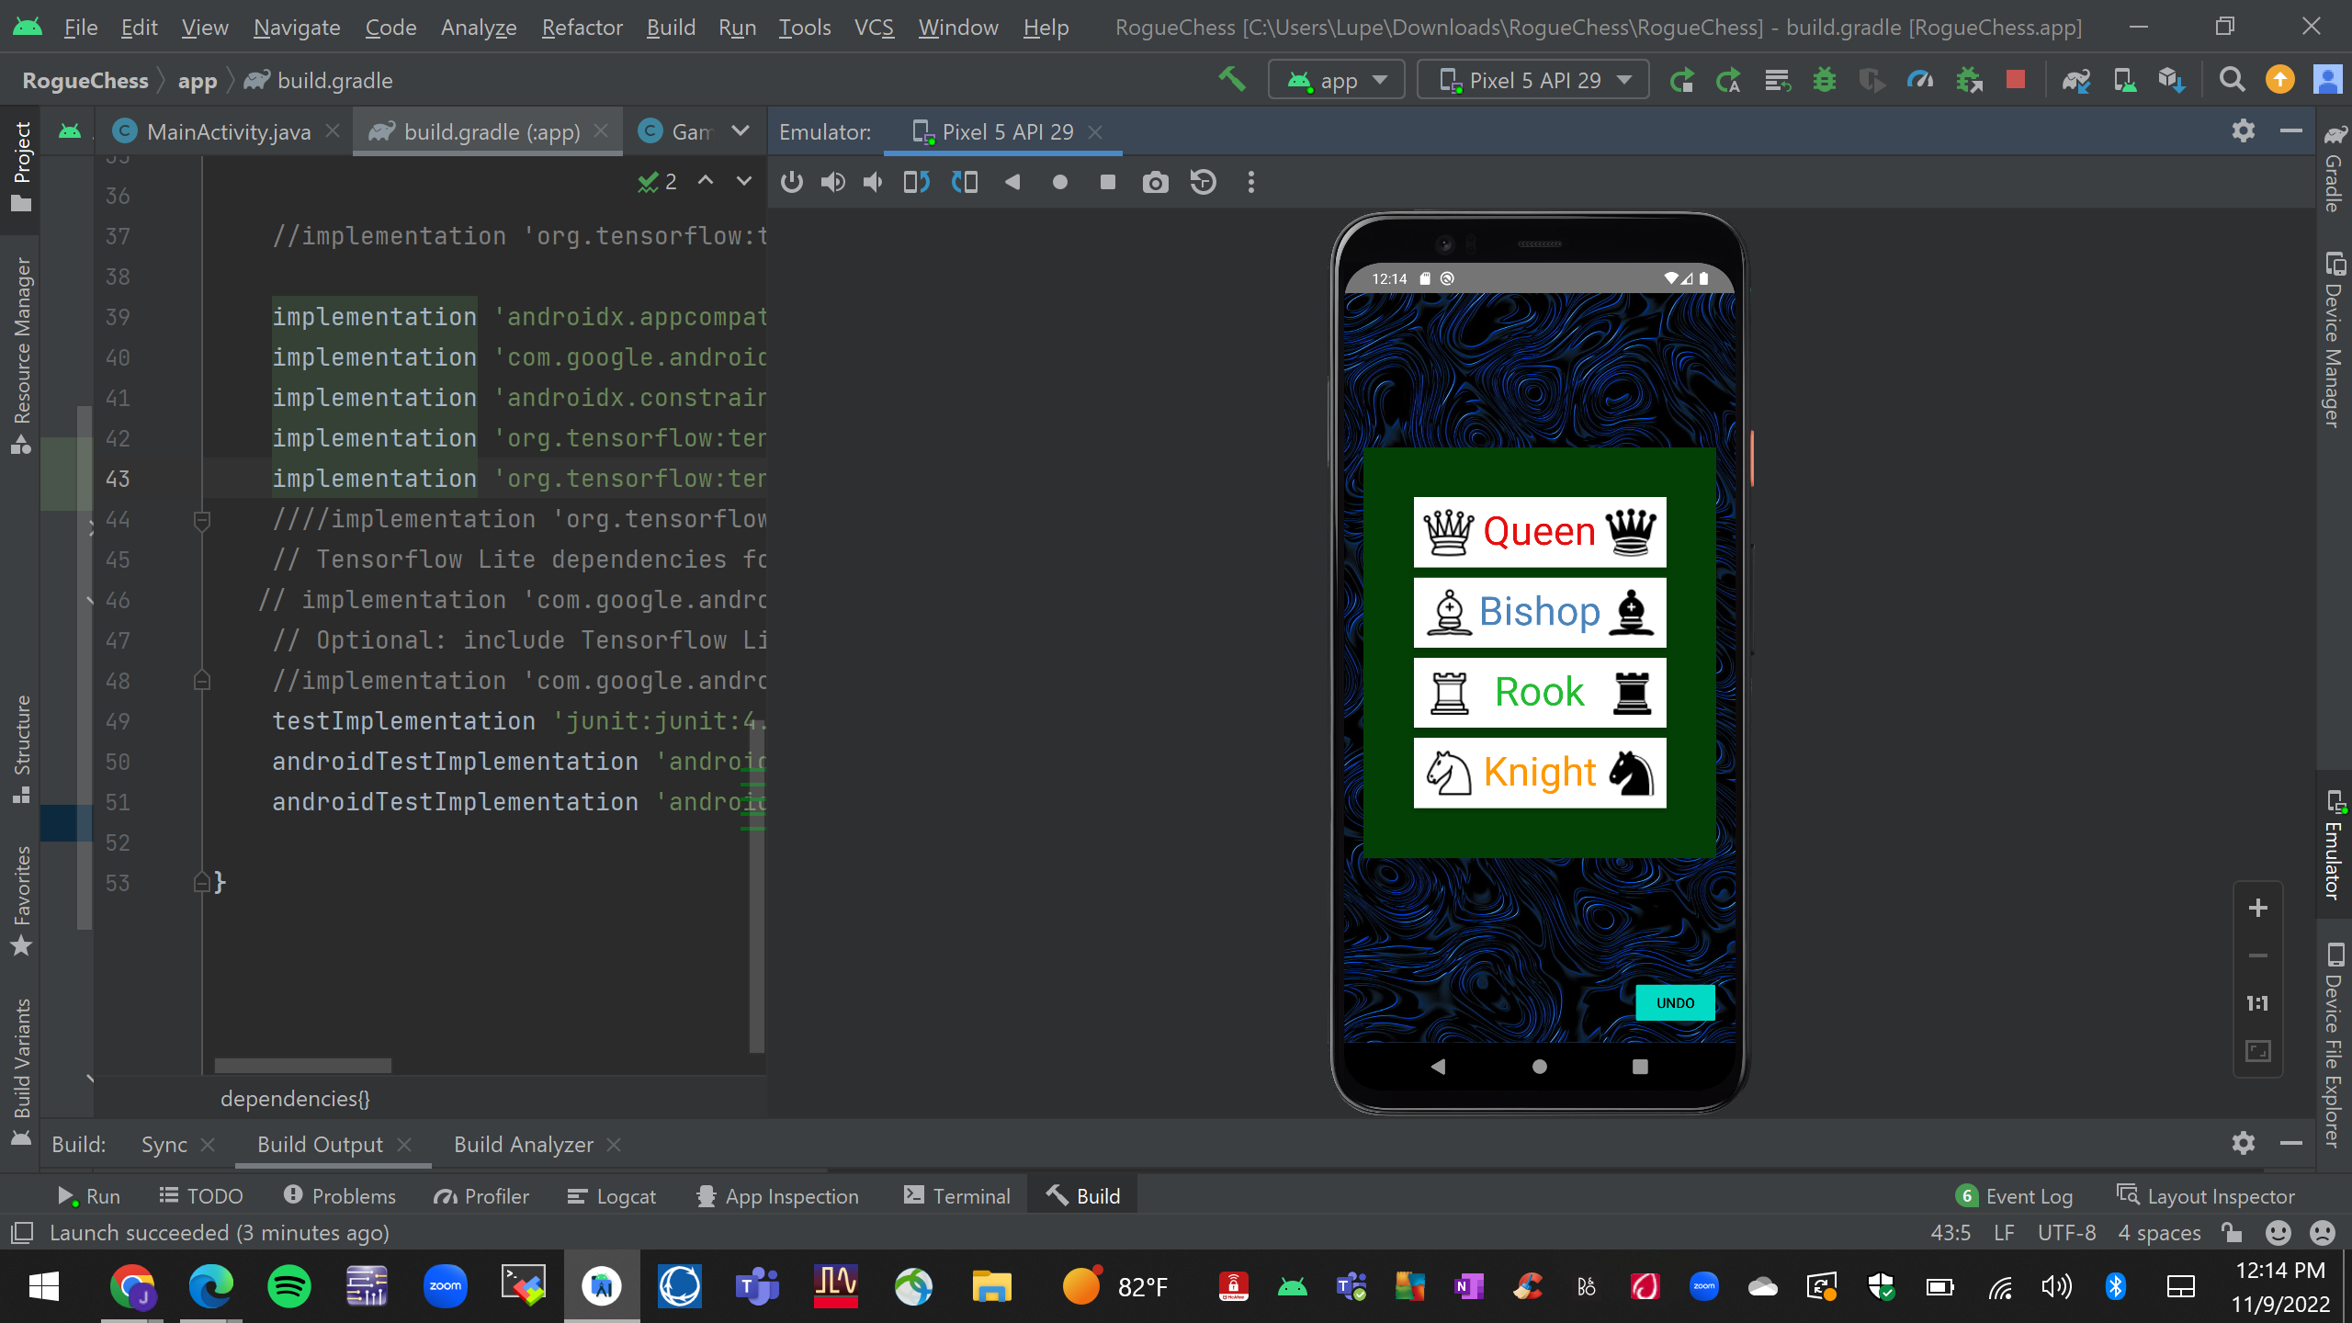
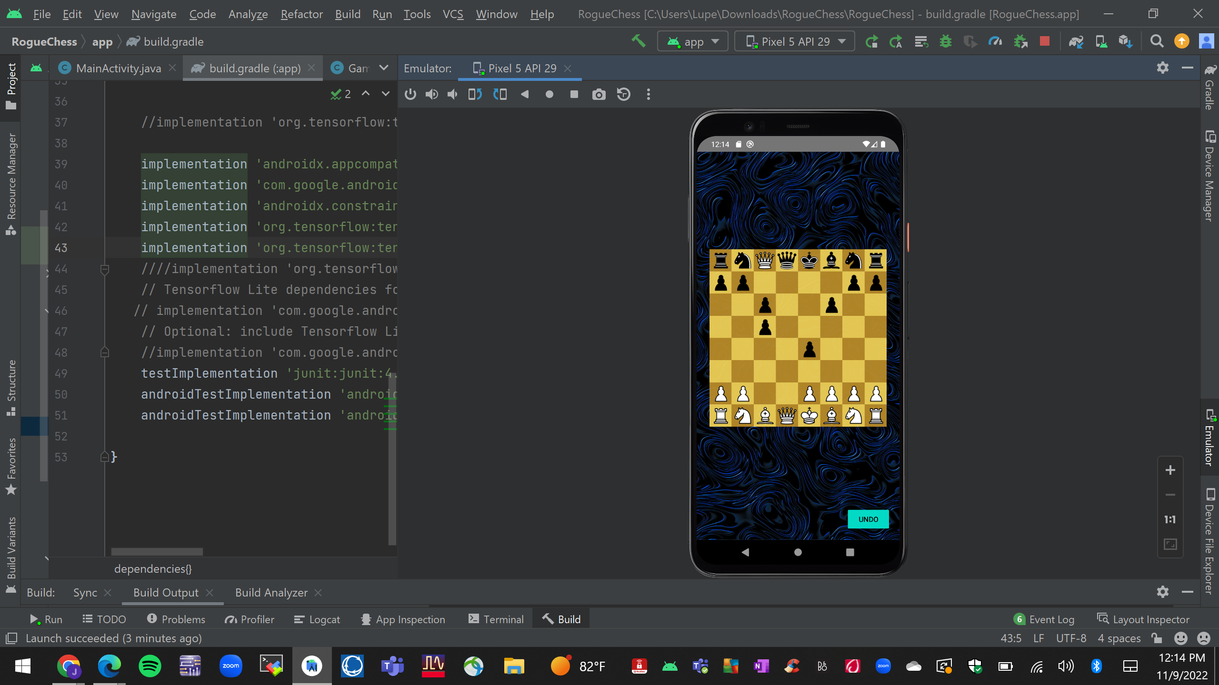
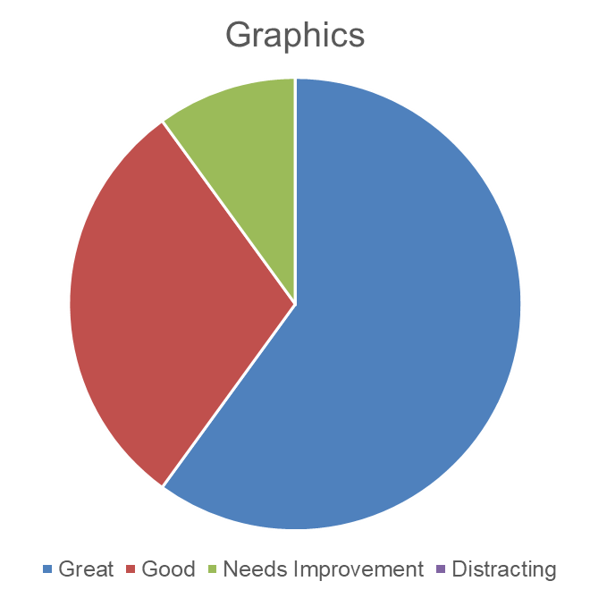
Game Functionality Jose Herrera

Slide 7
Artificial Intelligence Design Travis Head
Recurrent Neural Network model
Tanh and ReLU activations
Preprocessed 50,000 chess games
Splitting board states
Splitting legal moves
Evaluating moves
Validations
Independent piece movement
Elo rating of A.I.
Move time

Slide 8
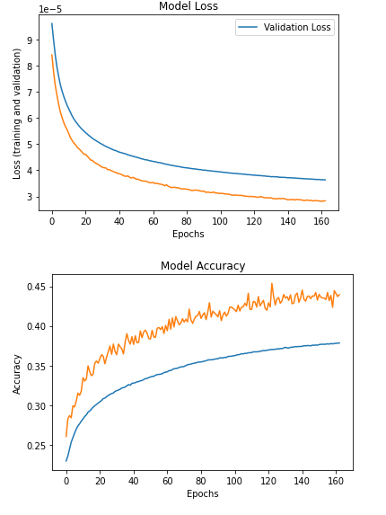
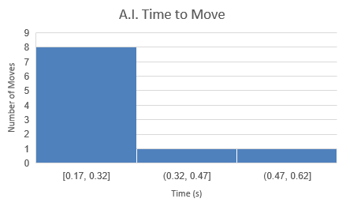
Artificial Intelligence Design Travis Head
Test Accuracy: 43.944%
Average time to move: 0.28 seconds

Slide 9
Artificial Intelligence Validation
Pieces Moved | Validated
Pawn | Tested
Knight | Tested
Bishop | Tested
Rook | Tested
Queen | Tested
King | Tested

Slide 10
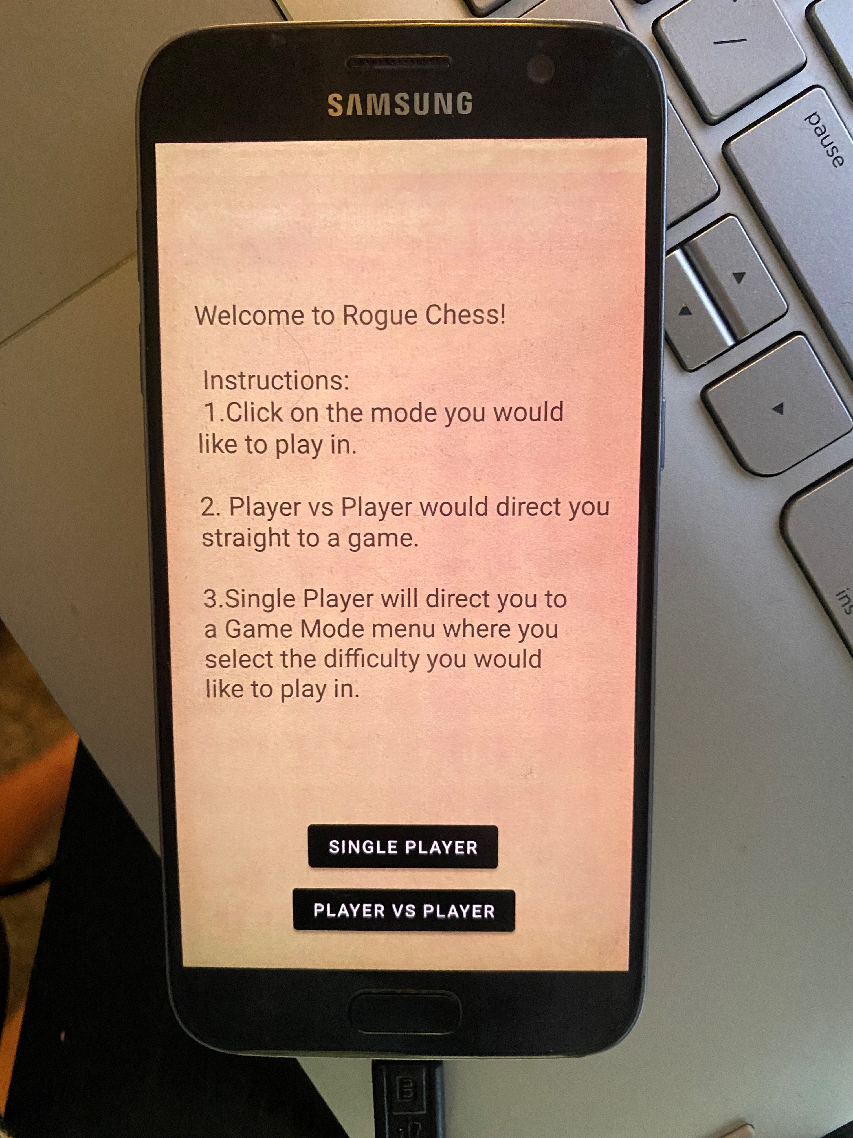
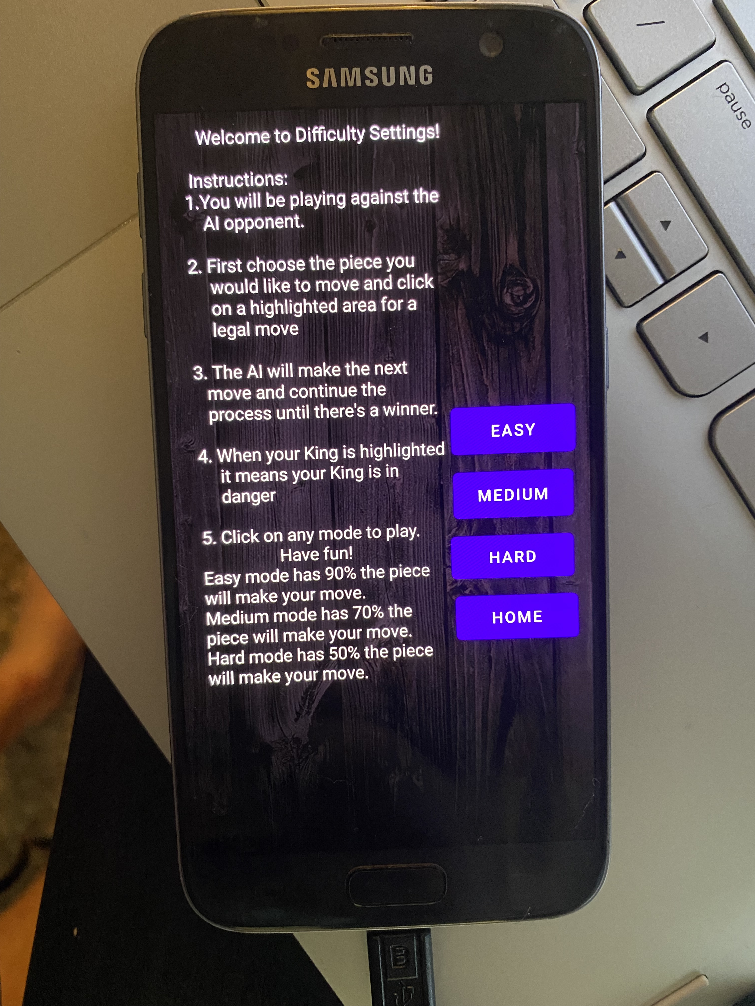
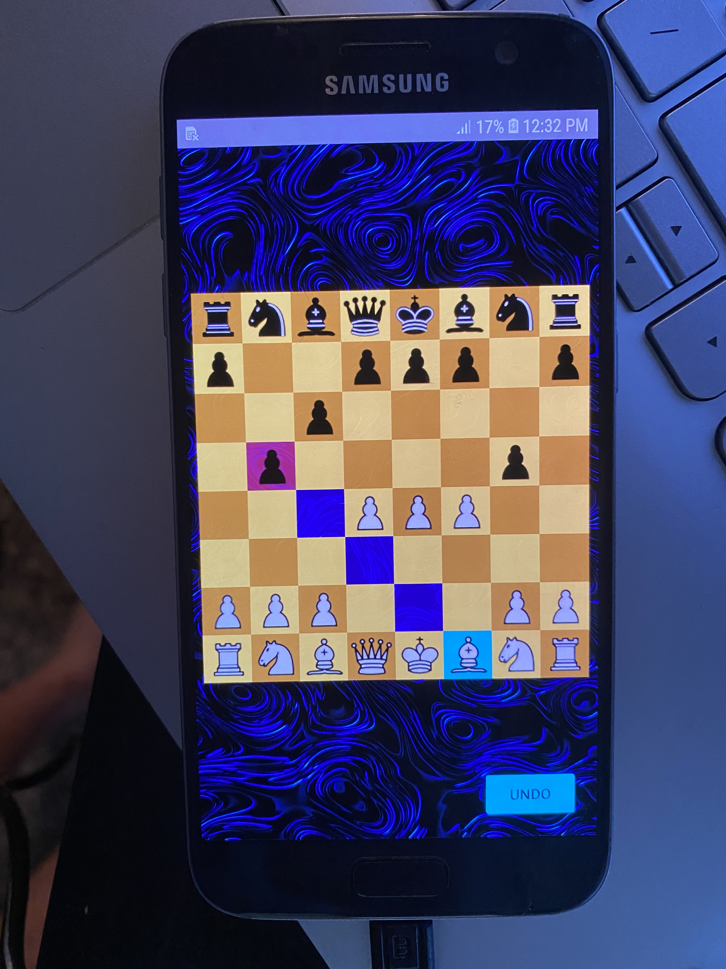
Integrated System Results

Slide 11
Integrated System Results
Test | Result | Expected
File Size | 21.7MB | 20MB
Response Time | 0.28 s | 2 s
Elo Rating | ~700 | ~1300
Number of Pieces Types Moved | 6 | 6
Randomization (50%, 70%, 90%) | 50%, 70%, 90% | 50%, 70%, 90%
Crashing | Single Player crashes | No Crashes

Slide 12
Project Mitigation
Fixing tflite issue
Update implementations
Possibly new model
Reduce file size
Delete unnecessary files/code
Testing for in-app movement of A.I.

Slide 13
Conclusions
Changes
Server concept abandoned
Directly integrated A.I. to app
Current Status
Integration mostly complete
Resolve Tensorflow Lite issue
Finish piece movement validation in app this week

Slide 14
Conclusions
What we learned
A LOT about chess
App building techniques
Machine Learning
Data processing
New Programming Language
Coordination between languages

Slide 15
Thank You!

